Slide 1
Business Statistics:
A First Course
(3rd Edition)
Chapter 1
Introduction and Data Collection

Slide 2
Chapter Topics
Why a Manager Needs to Know About Statistics
The Growth and Development of Modern Statistics
Some Important Definitions
Descriptive Versus Inferential Statistics

Slide 3
Chapter Topics
(continued)
Why Data Are Needed
Types of Data and Their Sources
Design of Survey Research
Types of Sampling Methods
Types of Survey Errors

Slide 4
Why A Manager Needs to Know About Statistics?
To Know How to Properly Present Information
To Know How to Draw Conclusions about Populations Based on Sample Information
To Know How to Improve Processes
To Know How to Obtain Reliable Forecasts

Slide 5
The Growth and Development of Modern Statistics
Needs of government to collect data on its citizenry
The development of the mathematics of probability theory
The advent of the computer

Slide 6
Some Important Definitions
A Population (Universe) Is the Whole Collection of Things Under Consideration
A Sample Is a Portion of the Population Selected for Analysis
A Parameter Is a Summary Measure Computed to Describe a Characteristic of the Population
A Statistic Is a Summary Measure Computed to Describe a Characteristic of the Sample

Slide 7
Population and Sample
Population
Sample
Use statistics to summarize features
Use parameters to summarize features
Inference on the population from the sample

Slide 8
Statistical Methods
Descriptive Statistics
  Collecting and describing data
Inferential Statistics
  Drawing Conclusions and/or making decisions concerning a population based only on sample data

Slide 9

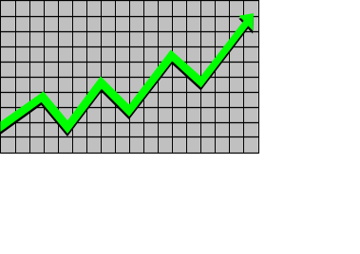
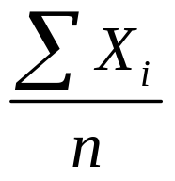
Descriptive Statistics
Collect Data
  e.g. Survey
Present Data
  e.g. Tables and graphs
Characterize Data
  e.g. Sample Mean =

Slide 10
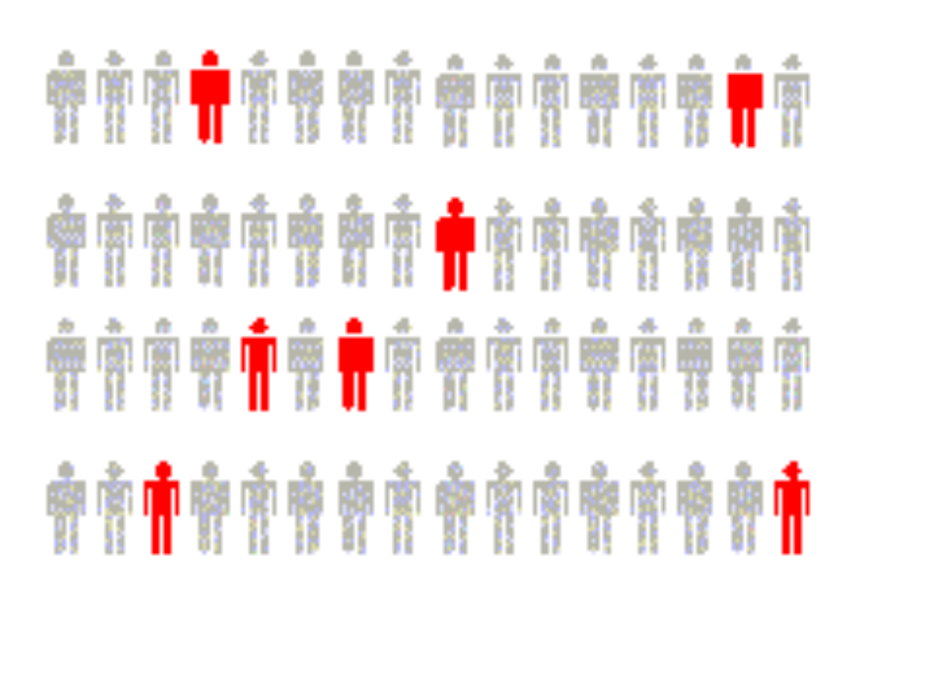
Inferential Statistics
Estimation
  e.g. Estimate the population mean weight using the sample mean weight
Hypothesis Testing
  e.g. Test the claim that the population mean weight is 120 pounds
Drawing conclusions and/or making decisions concerning a population based on sample results.

Slide 11
Why We Need Data
To Provide Input to Survey
To Provide Input to Study
To Measure Performance of Ongoing Service or Production Process
To Evaluate Conformance to Standards
To Assist in Formulating Alternative Courses of Action
To Satisfy Curiosity

Slide 12



Data Sources
Data Sources
Print or Electronic
Observation
Survey
Experimentation

Slide 13
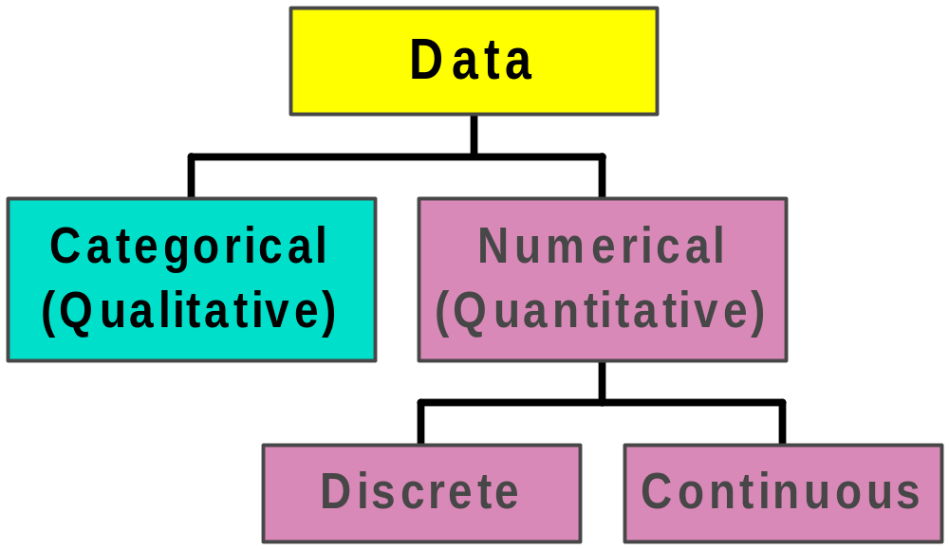
Types of Data

Slide 14
Design of Survey Research
Choose an Appropriate Mode of Response
  Reliable primary modes
    Personal interview
    Telephone interview
    Mail survey
  Less reliable self-selection modes (not appropriate for making inferences about the population)
    Television survey
    Internet survey
    Printed survey on newspapers and magazines
    Product or service questionnaires

Slide 15
Design of Survey Research
(continued)
Identify Broad Categories
  List complete and non-overlapping categories that reflect the theme
Formulating Accurate Questions
  Clear and unambiguous questions use clear operational definitions – universally accepted definitions
Testing the Survey
  Pilot test on small group of participants to assess clarity and length

Slide 16
Design of Survey Research
(continued)
Writing a Cover Letter
  State the goal and purpose of the survey
  Explain the importance of a response
  Provide assurance of respondent anonymity
  Offer incentive gift for respondent participation

Slide 17
Reasons for Drawing a Sample
Less Time Consuming Than a Census
Less Costly to Administer Than a Census
Less Cumbersome and More Practical to Administer Than a Census of the Targeted Population

Slide 18
Types of Sampling Methods
Samples
Probability Samples
Non-Probability Samples (Convenience)
Simple
Random
Stratified
Judgement
Chunk
Cluster
Systematic
Quota

Slide 19
Probability Sampling
Subjects of the Sample are Chosen Based on Known Probabilities
Probability Samples
Simple
Random
Systematic
Stratified
Cluster

Slide 20

Simple Random Samples
Every Individual or Item from the Frame Has an Equal Chance of Being Selected
Selection May be With Replacement or Without Replacement
One May Use Table of Random Numbers or Computer Random Number Generators to Obtain Samples

Slide 21

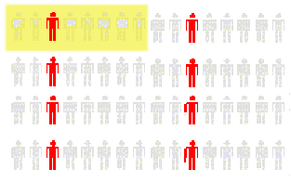
Systematic Samples
Decide on Sample Size: n
Divide Frame of N individuals into Groups of k Individuals: k=N/n
Randomly Select One Individual from the 1st Group
Select Every k-th Individual thereafter
N = 64
n = 8
k = 8
First Group

Slide 22

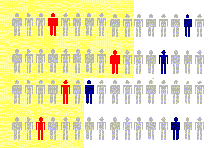

Stratified Samples
Population Divided into 2 or more Groups according to Some Common Characteristic
Simple Random Sample Selected from Each Group
The Two or More Samples are Combined into One

Slide 23

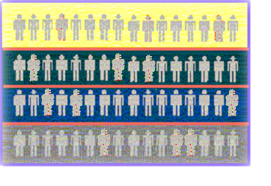
Cluster Samples
Population Divided into Several “Clusters,” Each Representative of the Population
A Random Sampling of Clusters is Taken
All Items in the Selected Clusters are Studied
Randomly selected 2 clusters.
Population divided into 4 clusters.

Slide 24
Advantages and Disadvantages
Simple Random Sample & Systematic Sample
  Simple to use
  May not be a good representation of the population’s underlying characteristics
Stratified Sample
  Ensures representation of individuals across the entire population
Cluster Sample
  More cost effective
  Less efficient (need larger sample to acquire the same level of precision)

Slide 25
Evaluating Survey Worthiness
What Is the Purpose of the Survey?
Is the Survey Based on a Probability Sample?
Coverage Error – Appropriate Frame
Nonresponse Error – Follow up
Measurement Error – Good Questions Elicit Good Responses
Sampling Error – Always Exists

Slide 26
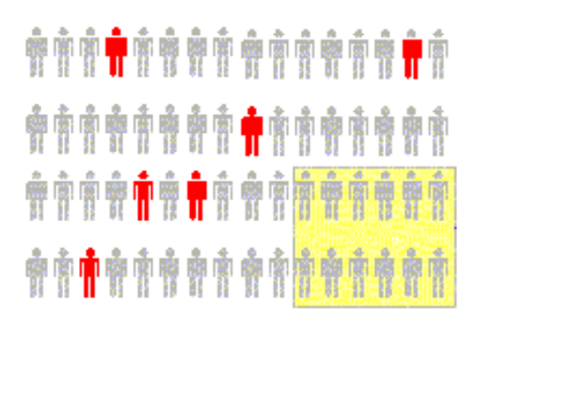

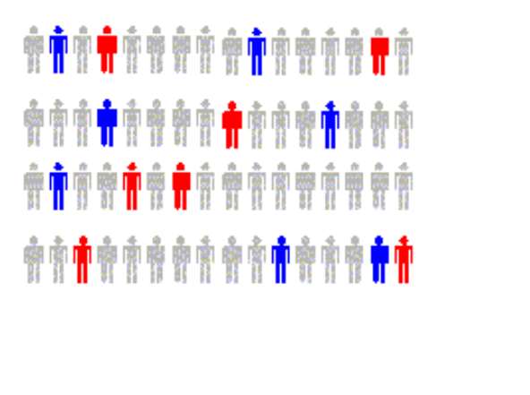
Types of Survey Errors
Coverage Error
Nonresponse Error
Sampling Error
Measurement Error
Excluded from frame.
Follow up on nonresponse.
Chance differences from sample to sample.
Bad Question!

Slide 27
Chapter Summary
Addressed Why a Manager Needs to Know about Statistics
Discussed the Growth and Development of Modern Statistics
Addressed the Notion of Descriptive versus Inferential Statistics
Discussed the Importance of Data

Slide 28
Chapter Summary
(continued)
Defined and Described the Different Types of Data and Sources
Discussed the Design of Surveys
Discussed Types of Sampling Methods
Described Different Types of Survey Errors

